Slide 1
Artificial Intelligence (AI)
Topic 2: Problem Solving Agents (Part -VIII)

Slide 2
Agenda
Informed Search Algorithms
Learning Outcomes : Searching Algorithms
Methodology and Assessment Criteria for the Subject

Slide 3
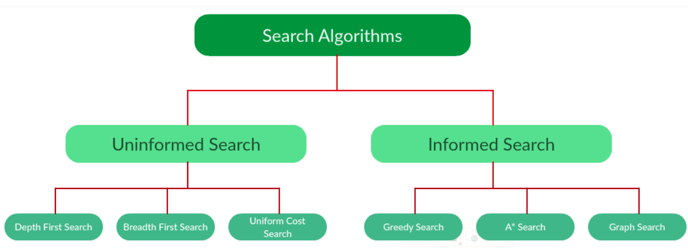
Types of Search Algorithms

Slide 4
Searching Strategies
Blind search → traversing the search space until the goal nodes is found (might be doing exhaustive search).
Techniques : Breadth First Uniform Cost ,Depth first, Interactive Deepening search.
Guarantees solution.
Heuristic search → search process takes place by traversing search space with applied rules (information).
Techniques: Greedy Best First Search, A* Algorithm
There is no guarantee that solution is found.

Slide 5
Example: Traveling Salesperson Problem
Suppose a salesperson has five cities to visit and them must return home. Goal → find the shortest path to travel.
A
B
75
125
125
100
75
E
50
125
C
50
D
100

Slide 6
Measuring Searching Performance
The output from problem-solving (searching) algorithm is either FAILURE or SOLUTION.
Four ways:
Completeness : is guaranteed to find a solution?
Optimality: does it find optimal solution ?
Time complexity: how long?
Space complexity: how much memory?
Complexity : branching factor (b), depth (d), and max. depth (m)

Slide 7
Review: Tree search
A search strategy is defined by picking the order of node expansion

Slide 8
Best-first search
Idea: use an evaluation function f(n) for each node
estimate of "desirability"
Expand most desirable unexpanded node
Implementation:
Order the nodes in fringe in decreasing order of desirability
Special cases:
greedy best-first search
A* search

Slide 9
Romania with step costs in km

Slide 10
Greedy best-first search
Evaluation function h(n) (heuristic)
h(n) = estimate of cost from n to goal
The better the estimate the better the solution
e.g., h_{SLD}(n) = straight-line distance from n to Bucharest
Greedy best-first search expands the node that appears to be closest to goal

Slide 11

Greedy best-first search example

Slide 12
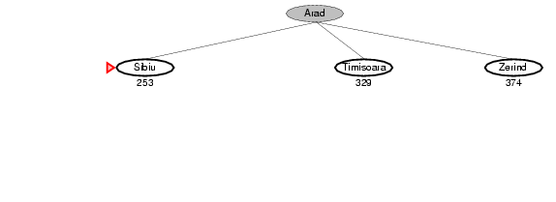
Greedy best-first search example

Slide 13
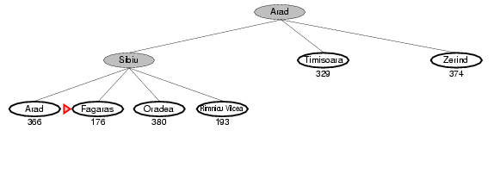
Greedy best-first search example

Slide 14
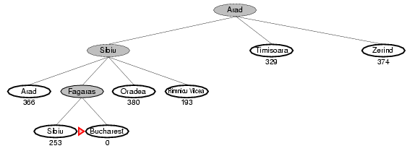
Greedy best-first search example

Slide 15
Properties of greedy best-first search
Complete? No – can get stuck in loops, e.g., Iasi → Neamt → Iasi → Neamt →
Time? O(b^{m}), but a good heuristic can give dramatic improvement
Space? O(b^{m}) -- keeps all nodes in memory Optimal? No (i.e., it might not find the optimal solution)

Slide 16
A* search
Idea: avoid expanding paths that are already expensive
Evaluation function f(n) = g(n) + h(n)
g(n) = cost so far to reach n (exact)
h(n) = estimated cost from n to goal
f(n) = estimated total cost of path through n to goal

Slide 17
A* search
A* search uses an admissible heuristic, i.e., h(n) · h*(n), where h*(n) is the true cost from n to goal node.
we also require h(n) ¸ 0, so that h(G) = 0 for any goal node G
h_{SLD}(n) never overestimates the actual road distance due to triangle inequality.
Theorem: A* search is optimal.
why? Intuition: it is good to be optimistic.

Slide 18

First, an A* search example

Slide 19
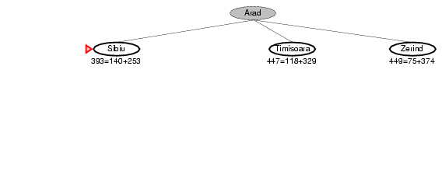
A* search example

Slide 20
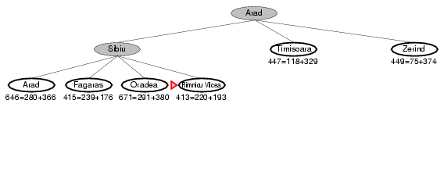
A* search example

Slide 21
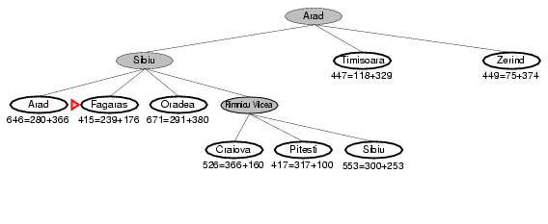
A* search example

Slide 22
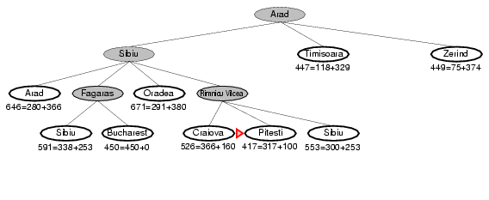
A* search example

Slide 23
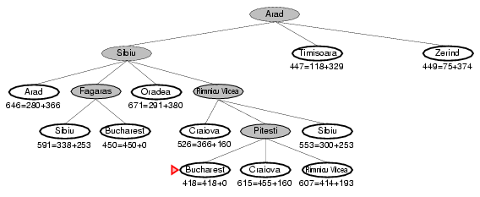
A* search example

Slide 24
Admissible heuristics
A heuristic h(n) is admissible if for every node n,
h(n) ≤ h*(n), where h*(n) is the true cost to reach the goal state from n. An admissible heuristic never overestimates the cost to reach the goal, i.e., it is optimistic Example: h_{SLD}(n) (never overestimates the actual road distance) Theorem: If h(n) is admissible, A* using TREE-SEARCH is optimal

Slide 25
Optimality of A* (proof)
Suppose some suboptimal goal G₂ has been generated and is in the fringe. Let n be an unexpanded node in the fringe such that n is on a shortest path to an optimal goal G.

Slide 26
Optimality of A* (proof)
contours
can be any
shape! The
better the
heuristic, the
more the shape
of the contour
becomes an
optimal path.

Slide 27
Properties of A*
Complete? Yes, unless there are infinitely many nodes with f · f(G) Time? Exponential in [relative error in h x length of solution] (i.e., low error if relative error is logarithmic)
Space? Keeps all nodes in memory Optimal? Yes, cannot expand f_{i+1} until f_{i} is finished.
A* expands all nodes with f(n) < C*
A* expands some nodes with f(n) = C*
A* expands no nodes with f(n) > C*

Slide 28
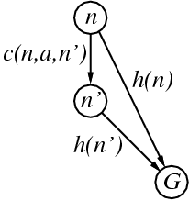
Consistent heuristics
A heuristic is consistent if for every node n, every successor n' of n generated by any action a, h(n) ≤ c(n,a,n') + h(n')
If h is consistent, we have
f(n') = g(n') + h(n')
= g(n) + c(n,a,n') + h(n')
≥ g(n) + h(n)
= f(n)
i.e., f(n) is non-decreasing along any path.
Theorem: If h(n) is consistent, A* using GRAPH-SEARCH is optimal

Slide 29
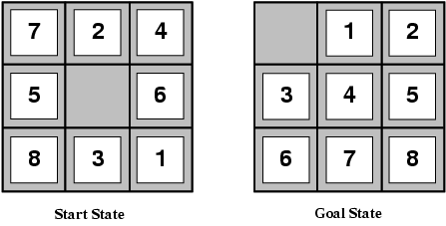
Admissible heuristics
E.g., for the 8-puzzle:
h₁(n) = number of misplaced tiles
h₂(n) = total Manhattan distance
(i.e., no. of squares from desired location of each tile)
h₁(S) = ?
h₂(S) = ?

Slide 30
Admissible heuristics
E.g., for the 8-puzzle:
h₁(n) = number of misplaced tiles
h₂(n) = total Manhattan distance
(i.e., no. of squares from desired location of each tile)
h₁(S) = ? 8
h₂(S) = ? 3+1+2+2+2+3+3+2 = 18

Slide 31
Dominance
If h₂(n) ≥ h₁(n) for all n (both admissible), then h₂ dominates h₁ and h₂ is better for search
Typical search costs (average number of nodes expanded): Comparing Iterative Deepening Search and A* search (for solution depth d):
d=12 IDS = 3,644,035 nodes A*(h₁) = 227 nodes A*(h₂) = 73 nodes
d=24 IDS = too many nodes A*(h₁) = 39,135 nodes A*(h₂) = 1,641 nodes
Moreover, given any admissible heuristic h_{a} and h_{b}, then h = max(h_{a},h_{b}) is also admissible and dominates h_{a} and h_{b}.

Slide 32
Relaxed problems
A problem with fewer restrictions on the actions is called a relaxed problem
The cost of an optimal solution to a relaxed problem is an admissible heuristic for the original problem
If the rules of the 8-puzzle are relaxed so that a tile can move anywhere, then h₁(n) gives the shortest solution
If the rules are relaxed so that a tile can move to any adjacent square, then h₂(n) gives the shortest solution
This can be a good way to generate heuristics.
Also, computer programs can themselves help to propose good heuristics (or we can learn heuristics).
Sometimes even if h is not admissible, we can do A* search and it works pretty well (Speech Recognition using “Stack Decoding”)

Slide 33
Some More Notes

Slide 34
Blind Search
Depth-first search and breadth-first search are examples of blind (or uninformed) search strategies.
Breadth-first search produces an optimal solution (eventually, and if one exists), but it still searches blindly through the state-space.
Neither uses any knowledge about the specific domain in question to search through the state-space in a more directed manner.
If the search space is big, blind search can simply take too long to be practical, or can significantly limit how deep we're able to look into the space.

Slide 35
Informed Search
A search strategy which searches the most promising branches of the state-space first can:
find a solution more quickly,
find solutions even when there is limited time available,
often find a better solution, since more profitable parts of the state-space can be examined, while ignoring the unprofitable parts.
A search strategy which is better than another at identifying the most promising branches of a search-space is said to be more informed.

Slide 36
Best-first search
To implement an informed search strategy, we need to slightly modify the skeleton for agenda-based search that we've already seen.
Again, the crucial part of the skeleton is where we update the agenda.
Rather than simply adding the new agenda items to the beginning (depth-first) or end (breadth-first) of the existing agenda, we add them to the existing agenda in order according to some measure of how promising we think a state is, with the most promising ones first. This gives us best-first search.
update_agenda(OldAgenda, NewStates, NewAgenda) :-
append(NewStates, OldAgenda, NewAgenda).
sort_agenda(NewStates, OldAgenda, NewAgenda).

Slide 37
Best-first search (2)
sort_agenda([], NewAgenda, NewAgenda).
sort_agenda([State|NewStates], OldAgenda, SortedAgenda):-
insert(State, OldAgenda, NewAgenda),
sort_agenda(NewStates, NewAgenda, SortedAgenda).
insert(New, [], [New]).
insert(New, [Old|Agenda], [New,Old|Agenda]):-
h(New,H), h(Old,H2), H =< H2.
insert(New, [Old|Agenda], [Old|Rest]):-
insert(New, Agenda, Rest).
This is a very general skeleton. By implementing sort_agenda/3, according to whatever domain we're looking at, we can make the search strategy informed by our knowledge of the domain.
Best-first search isn't so much a search strategy, as a mechanism for implementing many different types of informed search.
Compares heuristic
evaluation for
each state.

Slide 38
Uniform-cost search
One simple way to sort the agenda is by the cost-so-far. This might be the number of moves we've made so far in a game, or the distance we've travelled so far looking for a route between towns.
If we sort the agenda so that the states with the lowest costs come first, then we'll always expand these first, and that means that we're sure we'll always find an optimal solution first.
This is uniform-cost search. It looks a lot like breadth-first search, except that it will find an optimal solution even if the steps between states have different costs (e.g. the distance between towns is irregular).
However, uniform-cost search doesn't really direct us towards the goal we're looking for, so it isn't very informed.

Slide 39
Greedy Search
Alternatively, we might sort the agenda by the cost of getting to the goal from that state. This is known as greedy search.
An obvious problem with greedy search is that it doesn't take account of the cost so far, so it isn't optimal, and can wander into dead-ends, like depth-first search.
In most domains, we also don't know the cost of getting to the goal from a state. So we have to guess, using a heuristic evaluation function.
If we knew how far we were from the goal state we wouldn’t need to search for it!
0 Cost Max
local minimum = looping
Initial State Goal

Slide 40
Heuristic evaluation functions
A heuristic evaluation function, h(n), is the estimated cost of the cheapest path from the state at node n, to a goal state.
Heuristic evaluation functions are very much dependent on the domain used. h(n) might be the estimated number of moves needed to complete a puzzle, or the estimated straight-line distance to some town in a route finder.
Choosing an appropriate function greatly affects the effectiveness of the state-space search, since it tells us which parts of the state-space to search next.
A heuristic evaluation function which accurately represents the actual cost of getting to a goal state, tells us very clearly which nodes in the state-space to expand next, and leads us quickly to the goal state.

Slide 41
Example Heuristics
Manhattan Distance
The smallest number of vertical and horizontal moves needed to get to the goal (ignoring obstacles).
Straight-line distance
The distance between two locations on a map can be known without knowing how they are linked by roads (i.e. the absolute path to the goal).
E
A
B
C
ManhattanDistance
A = 4
E = 2
D
Problem
Space
S
E
F
C
G
H
X
A
S
=3
B
2=
E
A
=4
D
1=
H
B
=3
E
C
Search
Tree
2=
=2
G
C
B
F
=1
A
X

Slide 42
Combining cost-so-far and heuristic function
We can combine the strengths of uniform-cost search and greedy search.
Since what we're really looking for is the optimal path between the initial state, and some goal state, a better measure of how promising a state is, is the sum of the cost-so-far, and our best estimate of the cost from there to the nearest goal state.
For a state n, with a cost-so-far g(n), and a heuristic estimate of the cost to goal of h(n), what we want is:
f(n) = g(n) + h(n)
This proves to be a very effective strategy for controlling state-space search. When used with best-first search, as a way of sorting the agenda---where the agenda is sorted so that the states with the lowest values of f(n) come first, and are therefore expanded first---this is known as Algorithm A.

Slide 43
A* search and admissibility
The choice of an appropriate heuristic evaluation function, h(n), is still crucial to the behaviour of this algorithm.
In general, we want to choose a heuristic evaluation function h(n) which is as close as possible to the actual cost of getting to a goal state.
If we can choose a function h(n) which never overestimates the actual cost of getting to the goal state, then we have a very useful property. Such a h(n) is said to be admissible.
Best-first search, where the agenda is sorted according to the function f(n) = g(n) + h(n) and where the function h(n) is admissible, can be proven to always find an optimal solution. This is known as Algorithm A*.

Slide 44
BFS and Admissibility
Perhaps surprisingly, breadth-first search (where each step has the same cost) is an example of Algorithm A*, since the function it uses to sort the agenda is simply:
f(n) = g(n) + 0
Breadth-first search takes no account of the distance to the goal, and because a zero estimate cannot possibly be an overestimate of that distance it has to be admissible. This means that BFS can be seen as a basic example of Algorithm A*.
However, despite being admissible breadth-first search isn't a very intelligent search strategy as it doesn't direct the search towards the goal state. The search is still blind.

Slide 45
Informedness
We say that a search strategy which searches less of the state-space in order to find a goal state is more informed. Ideally, we'd like a search strategy which is both admissible (so it will find us an optimal path to the goal state), and informed (so it will find the optimal path quickly.)
Admissibility requires that the heuristic evaluation function, h(n) doesn't overestimate, but we do want a function which is as close as possible to the actual cost of getting to the goal.
Formally, for two admissible heuristics h1 and h2, if h1(n) <= h2(n) for all states n in the state-space, then heuristic h2 is said to be more informed than h1.

Slide 46
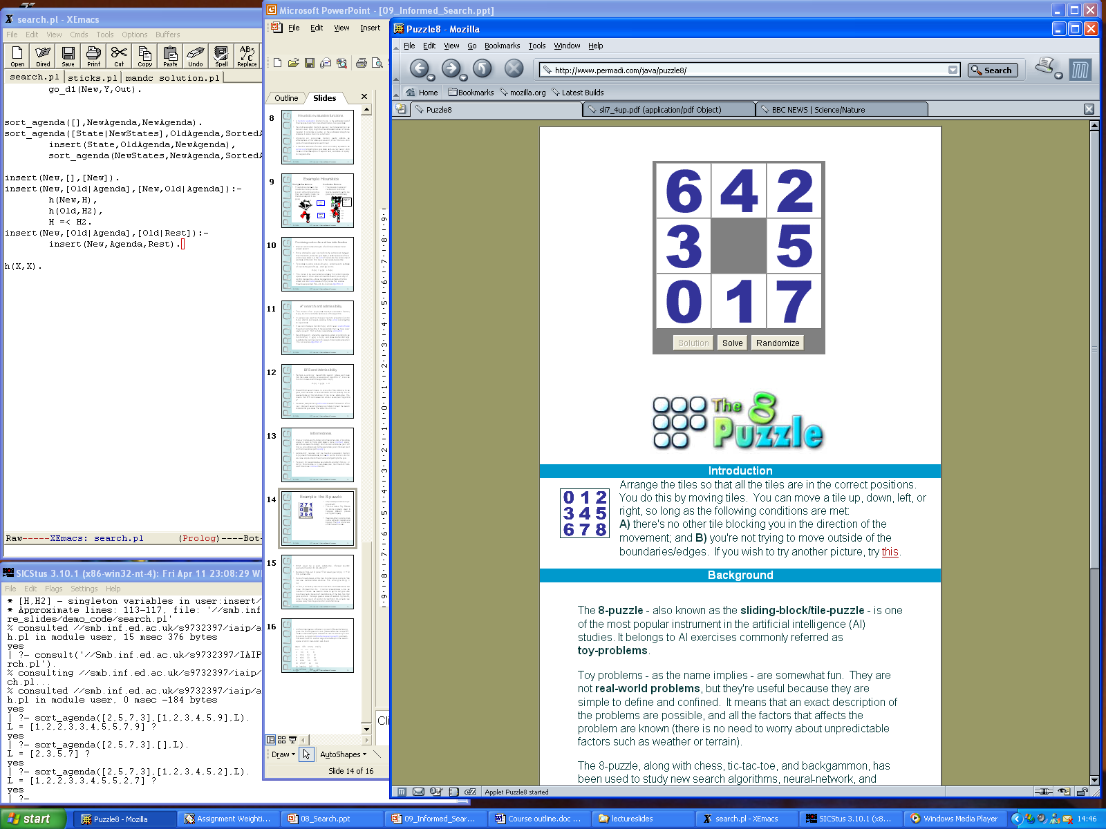
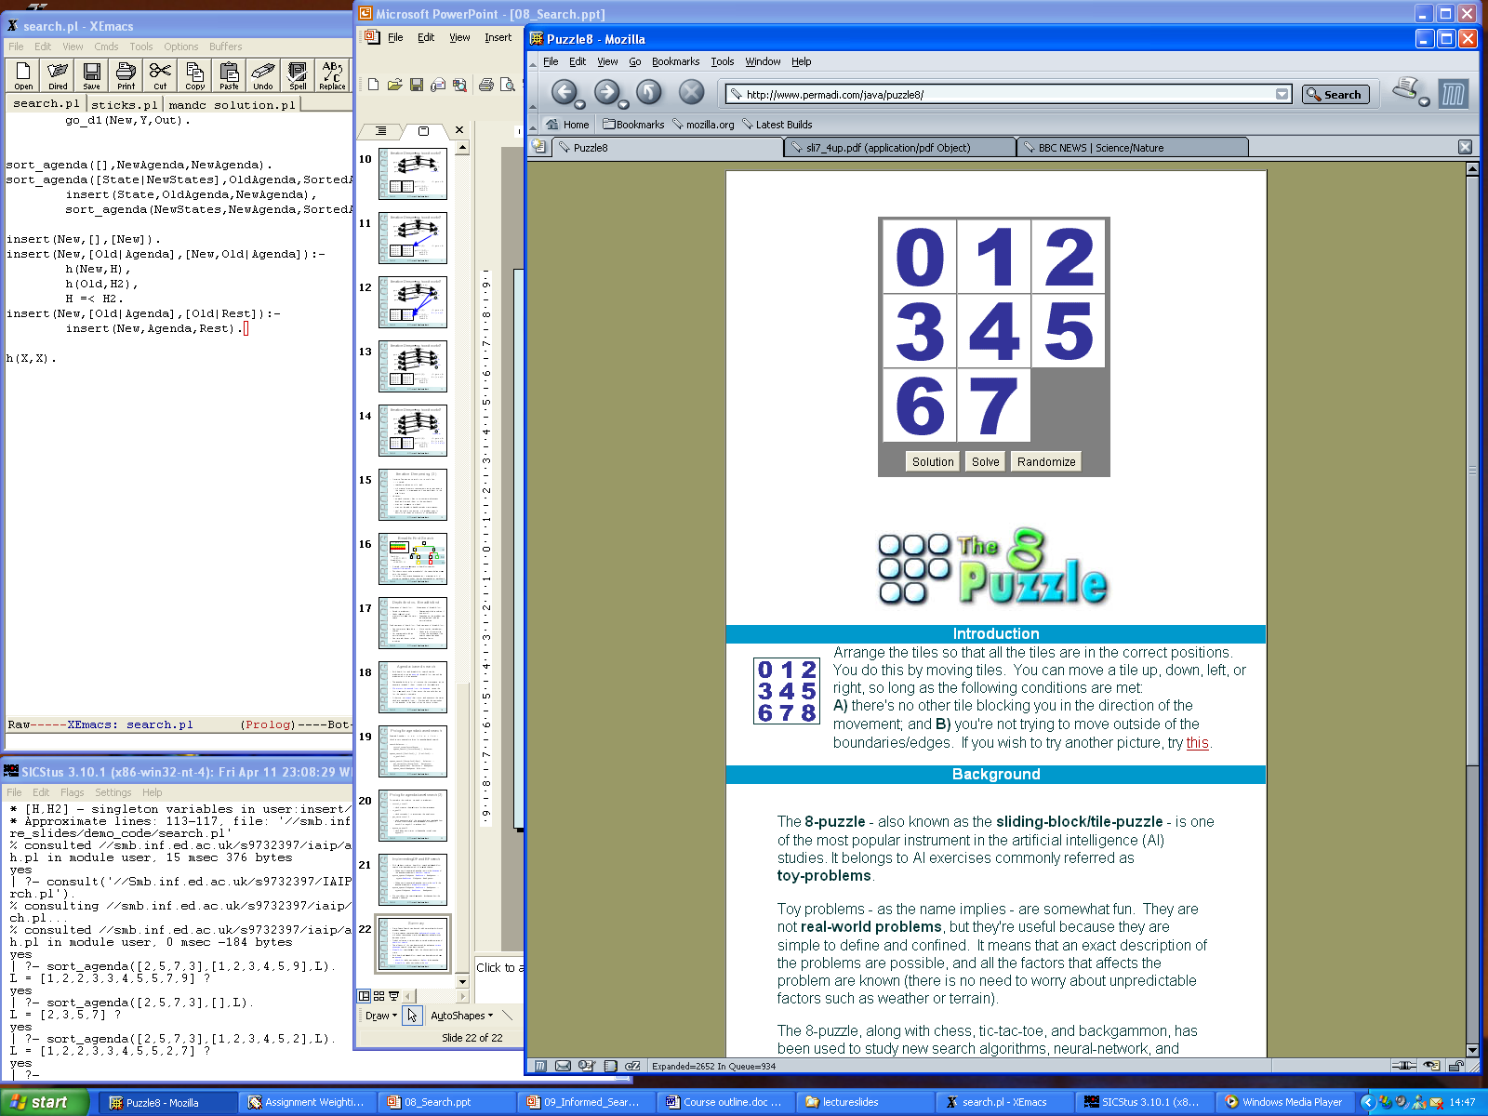
Example: the 8-puzzle
http://www.permadi.com/java/puzzle8/
This is a classic Toy Problem (a simple problem used to compare different problem solving techniques).
The puzzle starts with 8 sliding-tiles out of place and one gap into which the tiles can be slid. The goal is to have all of the numbers in order.
What would be a good, admissible, informed heuristic evaluation function for this domain?
START
GOAL

Slide 47
8-puzzle: heuristics
We could use the number of tiles out of place as our heuristic evaluation function. That would give h1(n) = 6 for this puzzle state.
We could also use the sum of the distances of the tiles from their goal positions i.e. the Manhattan distance. This would give h2(n) = 8.
In fact, it can easily be shown that h2 is both admissible and more informed than h1.
It cannot overestimate, since the number of moves we need to make to get to the goal state must be at least the sum of the distances of the tiles from their goal positions.
It always gives a value at least as high as h1, since if a tile is out of position, by definition it is at least one square away from its goal position, and often more.

Slide 48
Comparing Search Costs
If we compare the search costs for different search strategies used to solve the 8-puzzle.
We can calculate search costs as the number of nodes in the state-space looked at to reach a solution.
h2 dominates h1 = for any node, n, h2(n) >= h1(n).
It is always better to use a heuristic function with higher values, as long as it does not overestimate (i.e. it is admissible).
Solution at depth | Iterative Deepening Search | A* (h1) = Num. tiles out. | A* (h2) = Manhat. Dist.
2 | 10 | 6 | 6
4 | 112 | 13 | 12
6 | 680 | 20 | 18
8 | 6384 | 39 | 25
10 | 47127 | 93 | 39
12 | 364404 | 227 | 73
14 | 3473941 | 539 | 113

Slide 49
Summary
Blind search: Depth-First, Breadth-First, IDS
Do not use knowledge of problem space to find solution.
Informed search
Best-first search: Order agenda based on some measure of how ‘good’ each state is.
Uniform-cost: Cost of getting to current state from initial state = g(n)
Greedy search: Estimated cost of reaching goal from current state
Heuristic evaluation functions, h(n)
A* search: f(n) = g(n) + h(n)
Admissibility: h(n)never overestimates the actual cost of getting to the goal state.
Informedness: A search strategy which searches less of the state-space in order to find a goal state is more informed.

Slide 50
Learning Outcomes with the Topic
Understanding the need of Search Algorithms

Slide 51
Methodology And Assessment Criterias
Class Assignment(s)
Each chapter being covered will have one assignment. The Case Studies will be given in line to the Changing with Speed across IT Projects in Kirirom
Internal Exam(s)
There will be 2 exams
Model Exam
There will be one Model Exam.
Semester Exam
There will be 1 Semester Exam

Slide 52

Thank You !
“An Algorithm Must Be Seen to Be Believed”
- Donald Knuth

